Slide 1
Analyzing Twitter Data
Kafle, Bir
Lama, Suman
Mohammed, Ayub

Slide 2
Scope
Will be answering three questions?
a) Why?
b) How?
c) What?
Lessons Learned
Execute/Explore the code
Question/Answer

Slide 3
Why Ebola?
Modern Endemic
Global Attention
Financial Impact
Religious Values and Beliefs
Several Social Incidents
Conclusion: All sectors are impacted

Slide 4
How did we analyze?
Collected tweets – Across Various Regions: Asia, US, Europe and Africa
Ran code during day and night as time zone differs for all regions.
Drew graphs for regions; using geolocation.
Used other language feed as well – Arabic, French, Swahili, Spanish

Slide 5
What did we find?
US origin tweets most common
a) Twitter users in US high.
b) Access of technology in US is much higher compared to the US.
2. Most common words excluding articles/unrelated words
a) Most of them are retweets.
b) US was mentioned higher than any other region.
c) HolyQuaran – Religious Beliefs/Values
3. Frequency of words
a) Sharp decline between top words and middle words
b) Big range between top 30 words (difference of 400)
c) Village comes frequently which means disease is associated with village region.

Slide 6
Lessons Learned
First Data Analytics project for all three of us.
Good Knowledge on using API’s.
Experience on retrieving, storing and analyzing data.
Vast amount of RAW data present.
Converting RAW data into Information values could be challenging at times.
Working in team helped to share knowledge and experiences; which was crucial.

Slide 7
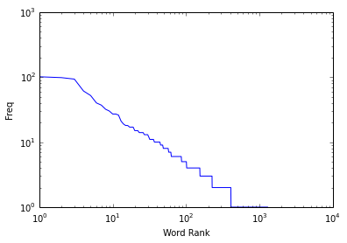
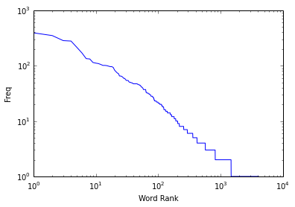
Graphs/Diagrams
Small Pool of Data – 200 Tweets
Large pool of data – 1000 Tweets
Both Graphs look similar – Data size didn’t impact the overall trend of results.

Slide 8
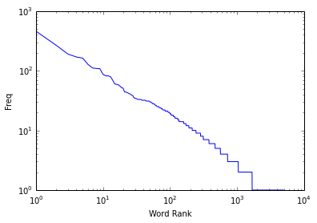
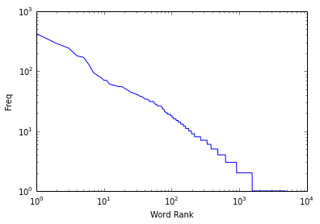
Graphs/Diagrams
US Early Morning Tweets
US Office Hours Tweets

Slide 9
Graphs/Diagrams
US Evening Tweets
Africa Evening Tweets

Slide 10
CODE EXECUTION & EXPLORATION

Slide 11


Slide 12
Acknowledgement/Citation
Python Documentation
Twitter Developer’s API Guide
Professor X. Kong
DS 501 Class Slides
Mining the Social Web 2nd Edition

